Slide 1
Advance Software Engineering
Architecture Design
Ms. Shehla Saeed

Slide 2
What is Design?
Design allows you to model the system or product that is to be built.
Design helps to understand Technical details better.
Design is a Process of Converting:
What to do?? =======➔ How to do? (R.E) (Design)

Slide 3
What is Design?
Design is what almost every engineer wants to do, core of engineering process
It is the place where creativity rules—where
stakeholder requirements,
business needs,
and technical considerations
all come together in the formulation of a product or system

Slide 4
What is Design?
The design model provides detail about
software architecture,
data structures,
interfaces, and
Components
that are necessary to implement the system

Slide 5
System
A system is a collection of components organized to accomplish a specific function or set of functions
(IEEE Std. 610.12-1990)

Slide 6
Software Architecture
The software architecture of a program or computing system is the structure or structures of the system, which comprise software elements, and the relationships among them

Slide 7
Software Architecture
Architectural design represents the structure of data and program components that are required to build a computer-based system.

Slide 8
Why is it important?
You wouldn’t attempt to build a house without a map, would you?
You’d need to look at the big picture—the house itself—before you worry about details.
That’s what architectural design does—it provides you with the big picture and ensures that you’ve got it right

Slide 9
Why is it important?
Representations of software architecture is an enabler for communication between all parties (stakeholders)
The architecture highlights early design decisions that provide you solid foundations on which software will be built

Slide 10
Software Architecture
Software architecture is:
An overall view of the solution to a problem
The high-level design of modular components and how they interact
A foundation that one can build on to solve a problem (e.g., rules, policies, attributes, etc.)

Slide 11
Software Architecture Styles
- Repository Architecture
- Client–Server Architecture
- Layered Architecture
- Pipe and Filter Architecture
- Microservices Architecture
- Distributed Architecture

Slide 12
Repository Architecture
The Repository Architecture (also called Shared Data System) is a design style where all system components share a central data store (repository) to read, write, and exchange information.
Each component works independently, but they communicate indirectly through this shared repository.
Notes:
Key Concept
A central repository (database or data store) is the heart of the system.
Subsystems (components) perform operations like reading, updating, and processing data stored in the repository.
The repository acts as a common communication medium between components.

Slide 13
Repository Architecture
Advantages: Centralized management, easy consistency.
Disadvantages: Single point of failure, hard to distribute.
Example: Git repository, Compiler (symbol table).
Notes:
Advantages
✅ Data Sharing Made Easy
All modules access the same repository, ensuring consistent data.
✅ Centralized Management
Data backup, security, and access control are easier to manage centrally.
✅ Scalability
New modules can be added easily if they use the same data model.
✅ Reduced Data Redundancy
Data is stored once and shared among components.
✅ Consistency and Integrity
A single source of truth avoids conflicts or duplicates.
Disadvantages
❌ Single Point of Failure
If the repository crashes, the whole system may stop working.
❌ Performance Bottleneck
Too many components accessing the same data can slow down the system.
❌ Complex Data Model
Repository structure must meet the needs of all components, which can be hard to design.
❌ Low Modularity
Changes in repository structure may require changes in all connected components.
❌ Security Risks
Centralized data makes the system vulnerable to breaches if not well protected.

Slide 14
How It Works
Each subsystem (like input, processing, or reporting) interacts only with the repository.
The repository stores all shared data.
When one component changes data, others can access the updated version immediately.

Slide 15
Example:
Compiler Design (Repository-style)
Central symbol table acts as repository
Components: Lexical analyzer, Parser, Semantic analyzer all access shared data

Slide 16
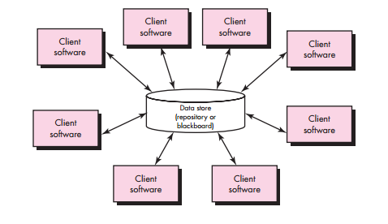
A Brief Taxonomy of Architectural Styles
Data-centered/ Repository architectures:

Slide 17
Client–Server Architecture
Concept: Divides system into clients (users) and servers (providers).
Working: Client sends request; server sends response.
Advantages: Centralized control, easy multi-client management.
Disadvantages: Server overload, network dependency.
Example: Web apps (browser & web server), Email systems.
Notes:
The Client–Server Architecture divides a system into two main parts:
Client: The front-end that interacts with the user.
Server: The back-end that provides services, processes requests, and stores data.
They communicate over a network using a request–response model:
Client sends a request to the server.
Server processes it and sends a response back.
🔹 Advantages
✅ Centralized control and management. ✅ Easier to maintain and update. ✅ Multiple clients can use one server. ✅ Data stored securely on the server.
🔹 Disadvantages
❌ Server overload if too many clients. ❌ Dependent on network connection. ❌ Single server failure can stop services.

Slide 18
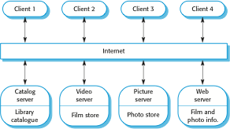
A client–server architecture for a film library

Slide 19
How It Works
Client (e.g., web browser, mobile app) asks for information or service.
Server (e.g., web server, database server) receives the request.
Server processes the request and returns the result to the client.
Flow: 💻 Client → (Request) → 🌐 Server → (Response) → 💻 Client
Notes:
Example : Email System
Client: Email application (e.g., Gmail app, Outlook)
Server: Mail server (SMTP for sending, IMAP/POP3 for receiving)
Process:
Client sends an email → SMTP server delivers it to recipient’s mail server.
Recipient’s email client retrieves it via IMAP or POP3.

Slide 20
Example : Email System
Client: Email application (e.g., Gmail app, Outlook)
Server: Mail server (SMTP for sending, IMAP/POP3 for receiving)
Process:
Client sends an email → SMTP server delivers it to recipient’s mail server.
Recipient’s email client retrieves it via IMAP or POP3.

Slide 21
Layered Architecture (N-tier)
Concept
The Layered Architecture organizes a software system into layers (or tiers), where each layer has a specific role and interacts only with the layer directly above or below it.
It promotes separation of concerns — each layer focuses on a single responsibility.

Slide 22
Layered Architecture (N-tier)
Advantages: Easy maintenance, scalability.
Disadvantages: Slower performance, rigid structure.
Example: Online shopping website.
Notes:
🔹 Advantages
✅ Easy to maintain and update (each layer can be modified independently). ✅ Supports scalability and reusability. ✅ Promotes clear structure and organization. ✅ Easy to test and debug.
🔹 Disadvantages
❌ Slightly slower performance due to multiple layers. ❌ Can be rigid — changes in one layer may require updates in others. ❌ Not ideal for real-time or high-speed systems.

Slide 23
A generic layered architecture

Slide 24
Layer | Function | Example
1. Presentation Layer (UI) | User interface; displays information and collects input | Web page, Mobile app
2. Application/Business Logic Layer | Implements system rules and logic | Order processing, validation
3. Data Access Layer | Handles database queries and data conversion | SQL commands, APIs
4. Database Layer | Stores actual data | MySQL, MongoDB

Slide 25
How It Works
User interacts with the Presentation Layer.
The Business Logic Layer processes the request.
The Data Access Layer retrieves or updates data from the Database Layer.
Results flow back up through the layers to the user.
Flow: User → UI → Business Logic → Data Access → Database ⬆️ Response follows the reverse path
Notes:
Each layer performs a defined task.
Communication happens only between adjacent layers.
Makes large applications easier to build, modify, and understand.

Slide 26
🛒 Example : E-Commerce Website
Presentation Layer: Website interface (HTML, CSS, React).
Business Logic Layer: Handles user login, payment rules, order management.
Data Access Layer: Executes SQL queries.
Database Layer: Stores products, users, orders (MySQL).
Flow: User → UI → Order Logic → SQL Queries → Database

Slide 27
Pipe and Filter Architecture
Concept:
The Pipe and Filter architecture is a data-flow design pattern where the system is organized as a series of processing steps (filters) connected by data channels (pipes).
Each filter takes input, processes it, and produces output that is passed to the next filter through a pipe
Notes:
Key Concept
Filter: Independent component that performs a specific transformation or computation on data.
Pipe: Connector that passes data from one filter to the next.
Data Flow: Data moves in one direction — from source to output.

Slide 28
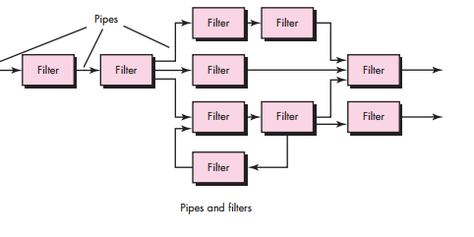
A Brief Taxonomy of Architectural Styles
Call and return/ Pipe & Filter architectures:

Slide 29
An example of the pipe and filter architecture

Slide 30
Pipe and Filter Architecture
Advantages: Easy modification, supports parallelism.
Disadvantages: Not interactive, requires compatible data formats
Notes:
Advantages
✅ Reusability: Filters can be reused in different systems. ✅ Maintainability: Easy to modify or add new filters without breaking the system. ✅ Simplicity: Each filter has a clear, single responsibility. ✅ Parallelism: Multiple filters can run in parallel (in some systems). ✅ Ease of Testing: Each filter can be tested separately.
Disadvantages
❌ Not suitable for interactive systems: Works best for batch or stream data. ❌ Error handling is complex: Failure in one filter can affect the entire chain. ❌ Performance overhead: Data must pass through several layers of filters. ❌ Rigid data format: All filters must agree on input/output format.

Slide 31
Compiler System
Explanation: A compiler processes source code through several stages — each acting as a filter. Filters:
Lexical Analyzer → breaks code into tokens
Syntax Analyzer → checks grammar
Semantic Analyzer → checks meaning
Code Generator → produces target code
Flow: Source Code → Lexical → Syntax → Semantic → Code Generator → Machine Code

Slide 32
Microservices Architecture
Concept:
Microservices Architecture is a software design style in which an application is divided into a collection of small, independent services that communicate with each other using APIs
Each microservice focuses on doing one specific business function and can be developed, deployed, and scaled independently.
Notes:
Key Concepts
Service Independence: Each microservice runs in its own process.
Decentralized Data Management: Every service may have its own database.
Communication: Services interact via lightweight protocols like HTTP/REST, message queues, or gRPC.
Automation: Uses DevOps tools for continuous integration and deployment (CI/CD).
Scalability: Services can be scaled individually.

Slide 33
Micro-services Architecture
Advantages: Scalable, fault-tolerant, flexible.
Disadvantages: Complex communication, harder debugging.
Examples
Netflix: Uses hundreds of microservices to handle streaming, recommendations, billing, etc.
Amazon: Every function (cart, payment, shipping) runs as a separate microservice
.Uber: Microservices for rides, payments, user management, and maps.
Notes:
Advantages
✅ Scalability: You can scale individual components based on demand.
✅ Independent Deployment: Teams can deploy updates without affecting other parts.
✅ Fault Isolation: If one service fails, the rest continue working.
✅ Technology Flexibility: Different services can use different programming languages or databases.
✅ Faster Development: Small teams work on different services in parallel.
Disadvantages
❌ Complex Communication: Requires managing network calls between services.
❌ Deployment Complexity: Many services mean more infrastructure management.
❌ Data Consistency Issues: Harder to maintain a single source of truth.
❌ Testing Challenges: End-to-end testing across multiple services is complicated.

Slide 34
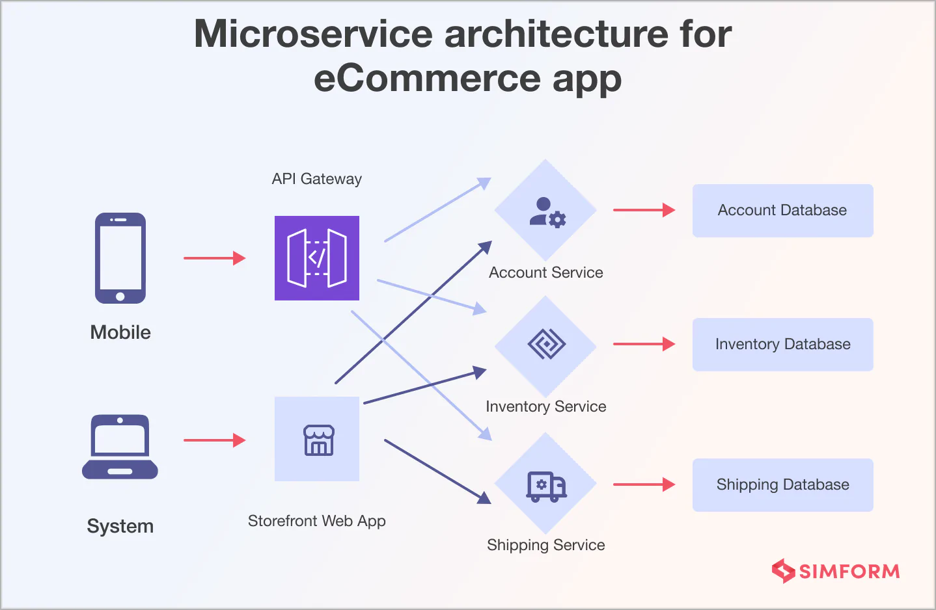

Slide 35
Monolithic Architecture
Monolithic Architecture is a software design where the entire application is built as a single, unified unit.
All components (UI, business logic, database access) are tightly integrated and deployed together.
Real-World Examples
Early versions of:
Facebook , Amazon
Many small systems like:
School management systems , Library systems, Basic web applications
Most systems follow this journey:
Monolithic → Modular Monolith → Microservices
Notes:
Best For:
Small projects
Startups (early stage)
Simple applications
Projects with small teams
❌ Not Ideal For:
Large-scale distributed systems
Applications needing frequent scaling
Complex enterprise systems

Slide 36
Structure of Monolithic System
A typical monolithic application contains:
1. Presentation Layer
User interface (UI)
Handles user interaction
2. Business Logic Layer
Core functionality
Processes rules and decisions
3. Data Access Layer
Interacts with database
Handles queries and storage
All these are packaged and run as one application

Slide 37
How It Works
User sends request
Entire application processes it internally
Response is returned
No external service calls (unlike microservices)
Advantages
Simple Development, Easy Deployment, Better Performance , Easier Testing
Disadvantages
Poor Scalability, Slow Development (team issues)
Notes:
Advantages
✔ 1. Simple Development
Easy to start (especially for small projects)
No need to manage multiple services
✔ 2. Easy Deployment
Only one executable/package
Deploy once → whole system runs
✔ 3. Better Performance (initially)
No network communication between components
Faster internal calls
✔ 4. Easier Testing (early stage)
Everything in one place
Disadvantages
❌ 1. Poor Scalability
Must scale the entire application, not parts
Inefficient resource usage
❌ 2. Hard to Maintain (large systems)
Code becomes complex over time
Small change → affects whole system
❌ 3. Slow Development (team issues)
Multiple developers working on same codebase → conflicts
❌ 4. Deployment Risk
A small bug → redeploy entire system
❌ 5. Technology Lock-in
Hard to use different technologies in one system

Slide 38
Event-Driven Architecture
What is EDA?
A design pattern where components communicate via events
An event = change in system state (e.g., order placed, login)
Core Idea
Producer → Generates events→ Example: User clicks “Buy Now”
Broker → Transfers events between components
Consumer → Listens and reacts to events →Example: Payment service processes payment
Key Components
Event Producer (Publisher)
Event Consumer (Subscriber)
Event Broker (e.g., Apache Kafka, RabbitMQ)
Notes:
Event
A message describing something that happened

Slide 39
How It Works
User performs an action
Producer creates an event
Event is sent to broker
Broker distributes event
Consumers process it independently.
Notes:
Advantages
✔ 1. Loose Coupling
Components don’t depend directly on each other
✔ 2. High Scalability
Add more consumers easily
✔ 3. Real-Time Processing
Immediate response to events
✔ 4. Flexibility
New services can subscribe without changing existing code
Disadvantages
❌ 1. Complex Debugging
Hard to trace event flow
❌ 2. Event Ordering Issues
Events may arrive out of order
❌ 3. Data Consistency Challenges
Eventual consistency (not immediate)
❌ 4. Higher Initial Complexity
Requires message brokers and event design

Slide 40
Real World Examples
Streaming PlatformsExample:
NetflixEvents:
User watches videos
Recommendation engine updates
🚗 Ride-Hailing AppsExample:
Uber Events:
Ride requested
Driver assigned
Ride completed

Slide 41
Distributed Architecture
Concept:
A software design where system components are located on different networked computers that communicate through message passing.
Key Idea:
Workload is distributed across multiple nodes, but they function as one logical system.
Characteristics:
- Multiple independent nodes
- Communication via network
- Resource sharing
- Scalable and fault-tolerant

Slide 42
Advantages and Disadvantages
Advantages:
- Improved performance
- Scalable
- Fault tolerant
- Enables resource sharing
Disadvantages:
- Complex communication & synchronization
- Security challenges
- Difficult debugging
- Network dependency
Notes:
Improved performance (parallel processing)
- Scalable (easy to add nodes)
- Fault tolerant (system continues even if one node fails)
- Enables resource sharing
Disadvantages:
- Complex communication & synchronization
- Security challenges
- Difficult debugging
- Network dependency

Slide 43
Types of Distributed Systems
1. Client–Server Systems – e.g., web apps
2. Peer-to-Peer (P2P) – e.g., file sharing networks
3. Three-Tier Systems – e.g., web apps with separate logic and database servers
4. Cloud-Based Systems – e.g., services spread across data centers

Slide 44
Examples
1. Google Search – distributed across thousands of servers for speed and reliability.
2. Online Banking – separate servers for login, transactions, and database.
3. Multiplayer Games – distributed game servers synchronize player actions.
4. Blockchain Network – peer-to-peer system with no central control.

Slide 45
Distributed System Diagram
Client A
Client B
Distributed Network
Server 1
Server 2
Server 3

Slide 46
Comparison Table
Repository – Shared data store – Git, Compiler – Data-centered systems
Client–Server – Request-response – Web app – Networked apps
Layered – Hierarchical layers – E-commerce – Enterprise software
Pipe & Filter – Sequential processing – Unix pipeline – Data processing
Microservices – Independent services – Netflix – Scalable systems
Distributed – Networked components – Google – Large-scale systems

Slide 47
Software Architecture
Architecture focuses on how the major elements and components within an application are used by, or interact with, other major elements and components within the application

Slide 48
Why is Architecture Important?
Systems should be designed with consideration for the user, the system, and the business goal
Business
System
User

Slide 49
Why is Architecture Important?
Consider the following high-level concerns when thinking about software architecture:
How will the users be using the application?
What are the quality attribute requirements for the application, such as security, performance, etc?
How can the application be designed to be flexible and maintainable over time?

Slide 50
The Goals of Architecture
Application architecture seeks to build a bridge between business requirements and technical requirements
The goal of architecture is to identify the requirements that affect the structure of the application
A good design is sufficiently flexible to be able to handle the natural change that will occur over time in hardware and software technology, as well as in user requirements

Slide 51
The Goals of Architecture
Keep in mind that the architecture should:
Expose the structure of the system but hide the implementation details
Realize all of the use cases and scenarios
Try to address the requirements of various stakeholders
Handle both functional and quality requirements

Slide 52
The Principles of Architecture Design
Current thinking on architecture assumes that your design will evolve over time and that you cannot know everything you need to know up front in order to fully architect your system
Your design will generally need to evolve during the implementation stages of the application
Create your architecture with this evolution in mind so that it will be able to adapt to requirements that are not fully known at the start of the design process

Slide 53
The Principles of Architecture Design
Consider the following questions as you create an architectural design:
What are the foundational parts of the architecture that represent the greatest risk?
What are the parts of the architecture that are most likely to change?
What are your key assumptions, and how will you test them?
What conditions may require you to re-factor the design?

Slide 54
The Principles of Architecture Design
Key Architecture Principles:
Build to change
Reduce risk
Use models and visualizations as a communication and collaboration tool
Identify key engineering decisions

Slide 55
Summary
- Architecture choice depends on project needs.
- Repository: centralized data.
- Client–Server: request/response model.
- Layered: structured organization.
- Pipe & Filter: data transformation.
- Microservices: scalability.
- Distributed: reliability and performance.

Slide 56
Design Patterns Object Oriented SE
Ms. Shehla Saeed

Slide 57
Architectural Style/design
An Architectural Style defines the overall structure and organization of a system at the highest level of abstraction.
👉 It answers:
How is the system organized overall?
What are the main components?
How do they interact globally?
Examples:
Client-Server: A central server provides resources to multiple client applications.
Microservices: The application is built as a collection of small, independent services that communicate over a network.
Layered (N-Tier): The system is organized into horizontal layers (e.g., presentation, business logic, database), where each layer only talks to the one directly below it.

Slide 58
Architectural Pattern (Implementation Strategy)
An Architectural Pattern is a reusable solution used to implement an architectural style.
👉 It answers:
How do we apply the style in practice?
How do components collaborate?
It adds best practices and rules to a style to guide implementation.
Examples:
MVC (Model-View-Controller) — often used in layered architectures
Broker Pattern — common in distributed systems
CORBA (Common Object Request Broker Architecture)
Message Brokers like RabbitMQ, Kafka, or Apache ActiveMQ
Notes:
CORBA is an Architectural Pattern / Middleware Architecture that enables communication between distributed objects across different systems.
👉 Developed by: Object Management Group (OMG)
🔹 Key Idea:
“Objects written in different languages and running on different machines can communicate seamlessly.”
MVC is an Architectural Pattern used to separate concerns in an application.
Components:
1. Model : Handles data & business logic
2. View : Handles UI (User Interface)
3. Controller : Handles user input & interaction
🔹 Flow:
User interacts with View
Controller receives input
Controller updates Model
Model updates View
🔹 Diagram:
User → View → Controller → Model → View
Components of Broker Pattern
🔹 1. Client
Requests services
🔹 2. Broker
Central coordinator
Finds appropriate server
Handles communication
🔹 3. Server (Service Provider)
Provides services
🔹 4. Stub (Client-side proxy)
Represents server locally
🔹 5. Skeleton (Server-side handler)
Receives request and executes it

Slide 59
Design Pattern (Low-Level Solution)
A Design Pattern is a solution to a localized problem within a small part of the system.
👉 It answers:
How should a specific piece of code be designed?
How do objects/classes interact?
Not a finished design: It is not code you can directly copy and paste.
A template: It is a description or template for how to solve a problem that can be used in many different situations.
Language Agnostic: Concepts apply to Java, C++, Python, C#, etc.
Notes:
Think of a design pattern like a blueprint.
If you want to build a house, the blueprint tells you where the walls go, but you still have to buy the bricks and lay them yourself.
Design patterns don't give you the exact code, but they give you the architectural strategy to solve a specific problem

Slide 60
Architectural vs design patterns
An Architectural Style is the application design at the highest level of abstraction; An Architectural Pattern is a way to implement an Architectural Style
A Design Pattern is a way to solve a localized problem.
In a few words, while Design Patterns impact a specific section of the code base
Architectural Patterns are high-level strategies that concern large-scale components, the global properties and mechanisms of a system.
Notes:
Architectural Style
This is the high-level view of a software system.
It defines the overall structure and how components interact.
Examples:
Client-Server
Layered Architecture
Event-Driven Architecture
Microservices Architecture
Architectural pattern
This is a specific way to implement an architectural style.
It adds best practices and rules to a style to guide implementation.
Examples:
MVC (Model-View-Controller) — often used in layered architectures
Broker Pattern — common in distributed systems
CORBA (Common Object Request Broker Architecture)
Message Brokers like RabbitMQ, Kafka, or Apache ActiveMQ
Microkernel Pattern- IDE software like Eclipse or VS Code (core + language/tool plugins)
Browser extensions — the browser is the kernel, and plugins extend it
This solves recurring, specific coding problems in part of your system.
Smaller in scope than architectural patterns.
Helps with code structure, flexibility, and reuse.
Examples:
Singleton
Observer
Factory
Strategy
Decorator

Slide 61
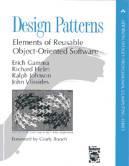
Design patterns
A Brief History (The Gang of Four)
Origin: Concept originated in civil engineering/architecture by Christopher Alexander.
Software Adoption: Popularized in 1994 by the book "Design Patterns: Elements of Reusable Object-Oriented Software".
The GoF: The four authors—Erich Gamma, Richard Helm, Ralph Johnson, and John Vlissides—are affectionately known in CS as the "Gang of Four" (GoF).
The Original 23: The book cataloged 23 fundamental patterns that are still used today.
1995 book Design Patterns: Elements of Reusable Object-Oriented Software is a classic of the field
Notes:
It's interesting that this started in physical architecture—designing buildings and towns.
The Gang of Four realized that software engineers were solving the same object-oriented problems over and over again.
By documenting these 23 patterns, they changed how software is engineered."

Slide 62
Why Use Design Patterns?
Proven Solutions: They are battle-tested by thousands of developers.
Code Reusability: Promotes writing code that is modular and adaptable.
Shared Vocabulary: Allows developers to communicate efficiently.
Instead of saying: "I wrote a class that only lets you create one instance of it and gives global access..."
You say: "I used a Singleton."
Faster Development: You don't have to reinvent the wheel.
Notes:
The biggest advantage is the shared vocabulary. When you join a tech company, your senior engineer won't explain a complex architecture from scratch.
They'll say, 'We use a Factory pattern here and an Observer pattern there.' Knowing these patterns allows you to instantly understand the system's architecture."

Slide 63
The Three Main Categories
The Gang of Four grouped the 23 patterns into three main categories based on their purpose:
Creational Patterns: Deal with object creation mechanisms.
Structural Patterns: Deal with object composition and relationships.
Behavioral Patterns: Deal with communication and assignment of responsibilities between objects.

Slide 64
Gang of Four (GoF) patterns
Creational Patterns (abstracting the object-instantiation process)
Factory Method Abstract Factory Singleton
Builder Prototype
Structural Patterns (how objects/classes can be combined)
Adapter Bridge Composite
Decorator Facade Flyweight
Proxy
Behavioral Patterns (communication between objects)
Command Interpreter Iterator
Mediator Observer State
Strategy Chain of Responsibility Visitor
Template Method
Notes:
To make it easier to digest, patterns are categorized by what they do.
Creational is about making objects.
Structural is about assembling objects into larger structures.
Behavioral is about how objects talk to each other."

Slide 65
Creational Patterns
Purpose: Hide the creation logic rather than instantiating objects directly using the new operator.
Why it matters: Gives the program more flexibility in deciding which objects need to be created for a given use case.
Common Examples:
Singleton
Factory Method
Builder
Notes:
"Using the 'new' keyword tightly couples your code to a specific class. Creational patterns help us abstract the instantiation process, making our systems independent of how their objects are created, composed, and represented."

Slide 66
Structural Patterns
Purpose: Explain how to assemble objects and classes into larger structures while keeping these structures flexible and efficient.
Focus: Interfaces and inheritance.
Common Examples:
Adapter
Decorator
Facade
Notes:
these are all about composing classes to form larger, more complex structures. They help guarantee that when one part of a system changes, the entire structure doesn't collapse."

Slide 67
Behavioral Patterns
Purpose: Concerned with algorithms and the assignment of responsibilities between objects.
Focus: How objects communicate and cooperate to perform a task.
Common Examples:
Observer
Strategy
Command
Notes:
Finally, Behavioral patterns. While creational is about 'building' and structural is about 'assembling', behavioral is about 'communicating'. It defines how objects interact and distribute the workload."

Slide 68
OOP Review
Abstract Method
Abstract class
Constructors
Concrete class
Interface

Slide 69
Abstract method
A method without body (no implementation) is known as abstract method.
Abstract method must always be declared in an abstract class, or in other words you can say that if a class has an abstract method, it should be declared abstract as well.
abstract keyword is used to create an abstract class and method.
Notes:
A method that is declared without an implementation (i.e., no body) in an abstract class or interface.
Subclasses are expected to provide the implementation.

Slide 70
Abstract Class
A class which is declared with the abstract keyword is known as an abstract class in Java.
It can have abstract and non-abstract methods (method with the body).
It can have final methods which will force the subclass not to change the body of the method.
Notes:
Cannot create objects directly from an abstract class.
Can include:
Abstract methods (no body)
Concrete methods (with body)
Fields (variables)
Constructors
Must be extended (inherited) by a subclass that provides implementation for the abstract methods.
Supports polymorphism and inheritance.

Slide 71
// Abstract class
abstract class Animal {
// Abstract method (does not have a body)
public abstract void animalSound();
// Regular method
public void sleep() {
System.out.println("Zzz");
}
}
// Subclass (inherit from Animal)
class Dog extends Animal {
public void animalSound() {
// The body of animalSound() is provided here
System.out.println("The dog says: woof woof");
}
}
class MyMainClass {
public static void main(String[] args) {
Dog myDog = new Dog(); // Create a Dog object
myDog.animalSound();
myDog.sleep();
}
}
Notes:
Abstract Class: Animal is an abstract class. That means:
You cannot create an object of Animal.
It can have abstract methods (without body).
It can also have regular methods (with body).
Abstract Method:
animalSound() is abstract → no body in Animal, but every subclass must implement it.
Subclass (Dog):
Inherits from Animal.
Provides body for the abstract method animalSound().
Main Method:
Pig myDog = new Dog(); creates an object of the Dog class.
myDog.animalSound(); calls the implemented method → prints pig's sound.
myDog.sleep(); calls the regular method from the parent class.
🖨️ Output:
The Dog says: woof woof
Zzz
Why Use Abstract Classes?
They’re useful when:
You want to define a common base for many subclasses.
Some methods should be mandatory to implement, while others can be optional.

Slide 72
Constructor
Constructor is a block of code that initializes the newly created object.
public class Hello
{
String name;
//Constructor
Hello()
{
this.name = "BeginnersBook.com";
}
public static void main(String[] args)
{
Hello obj = new Hello();
System.out.println(obj.name);
}
}
Notes:
A constructor is a special method in a class that is automatically called when an object of the class is created. Its main purpose is to initialize the object — for example, setting initial values of fields.
Has the same name as the class (in languages like Java, C++).
No return type, not even void.
Can be overloaded (multiple constructors with different parameters).
Can be default (no parameters) or parameterized (takes arguments).
In Python, the constructor is always named __init__.
TypeDescription
Default ConstructorTakes no parameters, used to set default values
Parameterized ConstructorTakes arguments, allows setting custom values
Copy Constructor (C++, optional in others)Creates a new object by copying another
public class Hello
{
String name;
A class Hello is defined.
It has an instance variable name of type String.
// Constructor
Hello()
{
this.name = "BeginnersBook.com";
}
This is a constructor — it’s a special method that runs automatically when an object of the class is created.
this.name refers to the current object’s name variable, and it assigns it the string "BeginnersBook.com".
public static void main(String[] args)
{
Hello obj = new Hello();
System.out.println(obj.name);
}
Inside the main method:
A new object obj of class Hello is created.
The constructor is called automatically and sets obj.name to "BeginnersBook.com".
System.out.println(obj.name); prints that value.
output
BeginnersBook.com
🧠 Why is this useful?
Constructors are commonly used to:
Initialize values when an object is created.
Provide default or custom setups for object creation.
Avoid setting values manually after creating an object.

Slide 73
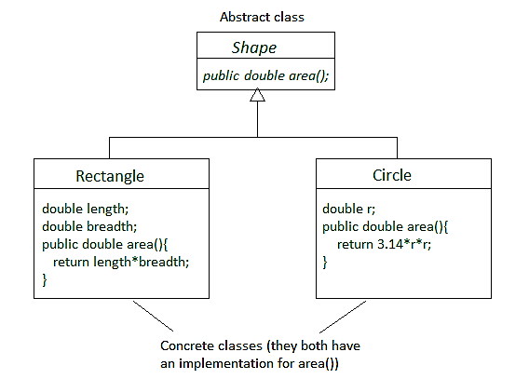
Concrete Class
A concrete class is a class that has an implementation for all of its methods.
They cannot have any unimplemented methods.
It can also extend an abstract class or implement an interface as long as it implements all their methods.
Notes:
A concrete class is a class that has a complete implementation — meaning:
✅ All its methods are fully defined (no abstract methods). ✅ It can be instantiated — you can create objects from it. ✅ It can inherit from abstract classes or implement interfaces and must provide code for all inherited abstract methods.
🔹 Key Characteristics
Can be used to create real objects.
Can include fields, methods, constructors, etc.
Can extend abstract classes and implement interfaces.
Represents actual implementations of behaviors and properties.

Slide 74
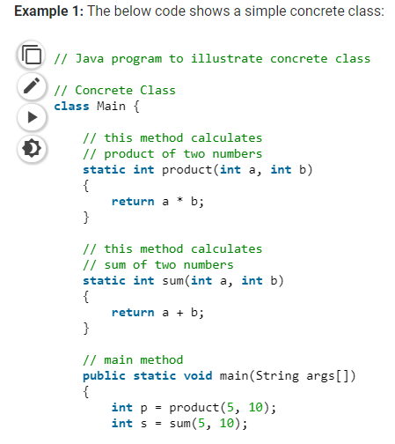
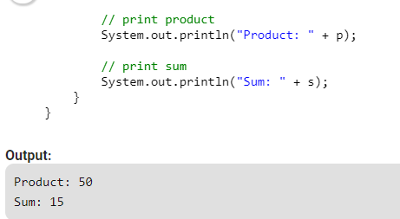
Notes:
This is a Java program that defines a concrete class named Main. It includes:
Two static methods:
product(int a, int b) → multiplies two integers.
sum(int a, int b) → adds two integers.
A main method that calls these methods and prints the results.
class Main {
This is a concrete class — it's complete and can be used directly (you can create objects or call static methods from it).
static int product(int a, int b) {
return a * b;
}
This method multiplies two integers and returns the result.
static int sum(int a, int b) {
return a + b;
}
This method adds two integers and returns the result.
public static void main(String args[]) {
int p = product(5, 10); // calls the product method: 5 * 10 = 50
int s = sum(5, 10); // calls the sum method: 5 + 10 = 15
The main method is the entry point.
It calls both methods with 5 and 10 as arguments.
Stores the results in variables p (product) and s (sum).

Slide 75
Concrete Method
A concrete method means, the method has complete definition but it can be overridden in the inherited class.
If we make this method "final" then it can not be overridden.
Declaring a method or class "final" means its implementation is complete.
Notes:
A concrete method is a fully implemented method — it has both a name, parameters, and a body (code that performs an action).
You can call it directly, and it does something when called.
Characteristics:
Belongs to a class (can be in regular or abstract classes).
Has a body with logic.
Unlike abstract methods, it is not abstract.
Can be inherited or overridden by subclasses.

Slide 76
// Abstract class
abstract class Animal {
// Abstract method (does not have a body)
public abstract void animalSound();
// Regular method
public void sleep() {
System.out.println("Zzz");
}
}
// Subclass (inherit from Animal)
class Dog extends Animal {
public void animalSound() {
// The body of animalSound() is provided here
System.out.println("The dog says: woof woof");
}
}
class MyMainClass {
public static void main(String[] args) {
Dog myDog = new Dog(); // Create a Dog object
myDog.animalSound();
myDog.sleep();
}
}
Notes:
abstract class Animal
This is an abstract class — you cannot create objects directly from it.
It contains:
A concrete method: sleep(), which has an implementation.
An abstract method: makeSound(), which has no body — it must be implemented in a subclass.
2. class Dog extends Animal
Dog is a subclass of Animal. It inherits everything from Animal.
Since Animal has an abstract method makeSound(), Dog must implement it.
Dog provides its own version of makeSound() which prints "Woof!".
3. public class Main { ... }
This is the class with the main() method — the entry point of the program.
Inside main():
Dog d = new Dog();
Creates a new Dog object.
d.makeSound(); // Calls Dog's method
Executes the makeSound() method → prints "Woof!"
d.sleep(); // Inherited from Animal
Executes the sleep() method from the parent class → prints "Zzz"
Output of the Program:
CopyEdit
Woof! Zzz

Slide 77
Interface
An interface is similar to class.
It is a collection of abstract methods.
A class implements an interface, thereby inheriting the abstract methods of the interface.
an interface may inherit multiple interfaces and a class may implement multiple interfaces.

Slide 78
Interface
A Java class can only extend one parent class.
Multiple inheritance ( extends ) is not allowed.
Interfaces are not classes, however, and a class can implement more than one interface.
The parent interfaces are declared in a comma-separated list, after the implements keyword.
Notes:
n interface is a contract or blueprint that defines a set of methods (and sometimes properties) that a class must implement.
It contains only method signatures (no implementation — unless you're in a modern language that allows default methods).
A class that implements an interface must provide code for all its methods.

Slide 79
// Interface
interface Animal {
public void animalSound(); // interface method (does not have a body)
public void sleep(); // interface method (does not have a body)
}
// Dog "implements" the Animal interface
class Dog implements Animal {
public void animalSound() {
// The body of animalSound() is provided here
System.out.println("The dog says: woof woof");
}
public void sleep() {
// The body of sleep() is provided here
System.out.println("Zzz");
}
}
class MyMainClass {
public static void main(String[] args) {
Dog myDog = new Dog(); // Create a Dog object
myDog.animalSound();
myDog.sleep();
}
}
Notes:
What the Code Does:
Defines an interface Animal with two methods: animalSound() and sleep().
A class Dog implements the Animal interface
and provides concrete implementations for those two methods.
In MyMainClass, it creates a Dog object and calls both methods.
Output
The Dog says: woof woof
Zzz
Why thi happens:
The interface Animal forces Dog to implement the behavior.
myDog.animalSound() calls the overridden method in Dog.
myDog.sleep() does the same for the sleep() method.

Slide 80
Real-world Analogy
Interface: A vehicle should have start(), stop(), drive() methods — just rules.
Abstract Class: A generic Vehicle class defines some common behavior (e.g., fuelCapacity) but leaves others like drive() to be defined by specific vehicles.
Concrete Class: A Car or Bike class implements all the methods — you can now make actual car/bike objects from it.

Slide 81
Factory Design Pattern
Ms. Shehla Saeed

Slide 82

Problem with Direct Object Creation
Tight Coupling in Code
When developers directly instantiate objects using the new keyword, the code becomes tightly coupled to specific classes. This makes it difficult to change implementations later, as multiple parts of the codebase may depend on concrete classes rather than abstractions.
Code Duplication and Maintenance Issues
Repeated object creation logic across different modules leads to duplication and inconsistency. If object creation changes, developers must update multiple locations, increasing the risk of bugs and making maintenance more complex and time-consuming.
Limited Scalability
Adding new types or variations of objects requires modifying existing code, violating the Open/Closed Principle. This reduces flexibility and makes systems harder to extend as requirements evolve in real-world applications.

Slide 83
What is the Factory Design Pattern?
Definition and Purpose
The Factory Design Pattern is a creational pattern that provides an interface for creating objects without specifying their exact class. It centralizes object creation logic, allowing the system to decide which class to instantiate at runtime.
Encapsulation of Object Creation
Instead of scattering object creation across the codebase, the factory pattern encapsulates it within a dedicated class or method. This promotes better organization and makes it easier to manage changes in object creation logic.
Promoting Loose Coupling
By relying on interfaces or abstract classes, the factory pattern reduces dependencies on concrete implementations. This enables flexibility and supports better testing, scalability, and maintainability in large applications.

Slide 84
Usage of Factory Method
Factory Design pattern is based on Encapsulation object oriented concept.
Factory method is used to create different object from factory often refereed as Item and it encapsulate the creation code. So instead of having object creation code on client side we encapsulate inside Factory method in Java.
Notes:
Applicability
Use the Factory Method when you don’t know beforehand the exact types and dependencies of the objects your code should work with.
The Factory Method separates product construction code from the code that actually uses the product. Therefore it’s easier to extend the product construction code independently from the rest of the code.
For example, to add a new product type to the app, you’ll only need to create a new creator subclass and override the factory method in it.
Use the Factory Method when you want to provide users of your library or framework with a way to extend its internal components.
Inheritance is probably the easiest way to extend the default behavior of a library or framework. But how would the framework recognize that your subclass should be used instead of a standard component?
The solution is to reduce the code that constructs components across the framework into a single factory method and let anyone override this method in addition to extending the component itself.
Use the Factory Method when you want to save system resources by reusing existing objects instead of rebuilding them each time.
You often experience this need when dealing with large, resource-intensive objects such as database connections, file systems, and network resources.
Let’s think about what has to be done to reuse an existing object:
First, you need to create some storage to keep track of all of the created objects.
When someone requests an object, the program should look for a free object inside that pool.
… and then return it to the client code.
If there are no free objects, the program should create a new one (and add it to the pool).

Slide 85
Elements of Factory method Pattern
Product (Interface / Abstract Class)
Defines the common interface for all objects the factory can create.
Ensures all products follow a consistent structure.

Slide 86
Concrete Products
These are the actual implementations of the Product.
Each class represents a specific type of object.

Slide 87
Creator (Factory Class / Factory Method)
Declares the factory method that returns a Product object.
May provide a default implementation or leave it abstract.

Slide 88
Client
The class that uses the factory to create objects.
Does NOT use new directly → relies on factory.

Slide 89
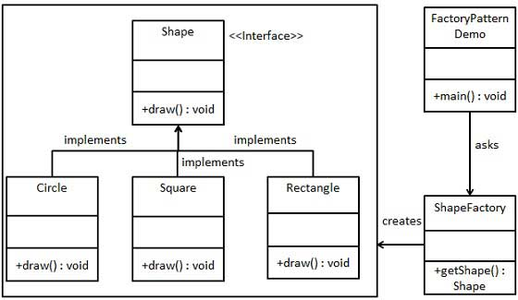
Notes:
Core Concept of the Factory Pattern:
The Factory Pattern is a creational design pattern that provides an interface for creating objects in a superclass, but allows subclasses to alter the type of objects that will be created.
📘 Components in the Diagram:
1. Shape Interface (Top Center)
This is the blueprint/interface that defines a common method: +draw(): void
+ means public.
Classes that implement this interface must define their own version of draw().
2. Concrete Classes: Circle, Square, Rectangle (Bottom Left)
These three classes implement the Shape interface.
Each provides its own implementation of the draw() method.
For example:
Circle.draw() might draw a circle.
Square.draw() might draw a square, etc.
3. ShapeFactory Class (Bottom Right Center)
This is the factory class responsible for creating objects of type Shape.
It has a method +getShape(): Shape that:
Accepts some input (like a string).
Returns an object of type Shape (could be Circle, Square, or Rectangle depending on the input).
4. FactoryPatternDemo Class (Top Right)
This is the main class (often the entry point).
It contains the main() method where:
The client asks the factory to create a specific shape.
The returned shape object is then used to call the draw() method.
🔄 Flow Summary:
FactoryPatternDemo → calls ShapeFactory.getShape("Circle")
ShapeFactory → returns an instance of Circle which implements Shape
FactoryPatternDemo → calls .draw() on the returned Shape object
✅ Why Use This Pattern?
Loose Coupling: The main program doesn’t need to know which class it’s instantiating.
Scalability: Easy to add new shapes (e.g., Triangle) without changing existing code.
Abstraction: You use a common interface to interact with different types of objects.

Slide 90
Step 1 : Interface
Create an interface.
Shape.java
public interface Shape
{
void draw();
}
Notes:
Interface is a keyword used to declare an interface in Java.
void draw(); is an abstract method by default — no body needed.
Any class that implements this interface must provide a concrete implementation of the draw() method.

Slide 91
Step 2: Concrete Classes
Create concrete classes implementing the same interface.
Rectangle.java
public class Rectangle implements Shape
{
@Override public void draw()
{
System.out.println("Inside Rectangle::draw() method.");
}
}
Notes:
@Override is an annotation used in Java to indicate that a method is being overridden from a superclass or interface.
It tells the compiler that you’re intentionally overriding a method.
If you make a mistake (like a typo), the compiler will catch it.
It makes your code easier to read and understand for others.

Slide 92
Step 2
Square.java
public class Square implements Shape
{ @Override public void draw()
{
System.out.println("Inside Square::draw() method.");
}
}
Notes:
public class Square implements Shape
This means:
Square is a class.
It implements the Shape interface — meaning it must provide a definition for all the methods declared in the Shape interface.
So if Shape has a method like void draw();, then Square must override that method.
✅ @Override
This annotation tells Java that you're overriding a method from the interface (Shape in this case).
It ensures you're not making mistakes like:
Spelling the method name wrong.
Using the wrong method signature.
✅ public void draw()
This is the method from the Shape interface that you're implementing.
All shape classes (like Rectangle, Circle, Square) will implement their own version of draw().
✅ System.out.println("Inside Square::draw() method.");
This is just a message to show that the draw() method for the Square object has been called.
It's helpful for debugging or demonstrating which shape’s method is running.

Slide 93
Step 2
Circle.java
public class Circle implements Shape
{
@Override public void draw()
{
System.out.println("Inside Circle::draw() method.");
}
}
Notes:
public class Circle implements Shape
This means:
You're creating a class named Circle.
It implements the Shape interface, so it must provide the body for all methods declared in the interface.
@Override
This annotation tells the compiler:
“I am overriding a method from an interface or superclass.”
public void draw()
This is the method from the Shape interface.
Each shape (Circle, Square, Rectangle, etc.) will give its own definition of how draw() works.
For this Circle class, it simply prints a message saying it's the circle’s version.
System.out.println("Inside Circle::draw() method.");
This is just a print statement that runs when the draw() method is called.
It helps you confirm that the Circle class's method is being used.

Slide 94
Step 3: Create Factory
Create a Factory to generate object of concrete class based on given information.
ShapeFactory.java
public class ShapeFactory
{
//use getShape method to get object of type shape
public Shape getShape(String shapeType)
{
if(shapeType == null){ return null;
}
if(shapeType.equalsIgnoreCase("CIRCLE"))
{ return new Circle();
}
else if(shapeType.equalsIgnoreCase("RECTANGLE"))
{
return new Rectangle();
}
else if(shapeType.equalsIgnoreCase("SQUARE"))
{
return new Square();
}
}
Notes:
public class ShapeFactory
This is your factory class.
It contains logic to create and return objects of different Shape types.
✅ public Shape getShape(String shapeType)
This is the factory method.
It takes a String (like "CIRCLE", "SQUARE", etc.).
Based on the string, it returns an object of the correct class (like new Circle()).
✅ if (shapeType == null)
If no shape name is given, the method returns null (nothing to create).
✅ shapeType.equalsIgnoreCase(...)
This checks the shape name without worrying about upper/lowercase (e.g., "circle", "CIRCLE", "Circle" all match).
It compares the given string and returns the right shape object:
"CIRCLE" → new Circle()
"RECTANGLE" → new Rectangle()
"SQUARE" → new Square()
✅ return new Circle() (or Rectangle/Square)
This is the main job of the factory — it creates an object of the appropriate class and gives it back to the caller.
The caller doesn’t need to know how the object is created — just that they get a shape.
✅ return null;
If the input doesn't match any known shape, the factory returns null.

Slide 95
Step 4
Use the Factory to get object of concrete class by passing an information such as type.
public class FactoryPatternDemo
{
public static void main(String[] args)
{
ShapeFactory shapeFactory = new ShapeFactory();
//get an object of Circle and call its draw method.
Shape shape1 = shapeFactory.getShape("CIRCLE");
//call draw method of Circle
shape1.draw();
Notes:
✅ ShapeFactory shapeFactory = new ShapeFactory();
Creates an instance of the factory.
You use this to get shape objects.
✅ Shape shape1 = shapeFactory.getShape("CIRCLE");
Factory receives the string "CIRCLE".
It checks and creates a Circle object.

Slide 96
Step 4
//get an object of Rectangle and call its draw method.
Shape shape2 = shapeFactory.getShape("RECTANGLE");
//call draw method of Rectangle
shape2.draw();
//get an object of Square and call its draw method.
Shape shape3 = shapeFactory.getShape("SQUARE");
//call draw method of square
shape3.draw();
}
}
Notes:
✅ shape1.draw();
Calls the draw() method from the Circle class.
Output:
Inside Circle::draw() method
Shape shape2 = shapeFactory.getShape("RECTANGLE");
shape2.draw(); // Output: Inside Rectangle::draw() method.
Shape shape3 = shapeFactory.getShape("SQUARE");
shape3.draw(); // Output: Inside Square::draw() method.

Slide 97
Output
Inside Circle::draw() method.
Inside Rectangle::draw() method.
Inside Square::draw() method.

Slide 98
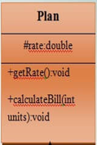


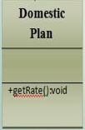

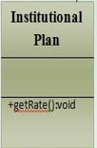
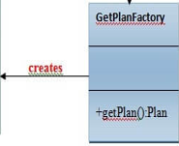

Slide 99
Calculate Electricity Bill : A Real World Example of Factory Method
Step 1: Create a Plan abstract class.
import java.io.*;
abstract class Plan{
protected double rate;
abstract void getRate();
public void calculateBill(int units){
System.out.println(units*rate);
}
}//end of Plan class.
Notes:
import java.io.*; // Import Java I/O package (not used here, but maybe for future input/output)
abstract class Plan { // Abstract class named Plan
protected double rate; // A protected variable to hold the rate (price per unit)
abstract void getRate(); // Abstract method: must be defined in subclasses
public void calculateBill(int units) {
System.out.println(units * rate); // Calculates and prints total cost
}
}

Slide 100
Step 2
Create the concrete classes that extends Plan abstract class.
class DomesticPlan extends Plan{
//@override
public void getRate(){
rate=3.50;
}
}

Slide 101
Step 2
class CommercialPlan extends Plan{
//@override
public void getRate(){
rate=7.50;
}
/end of CommercialPlan class.

Slide 102
Step 2
class InstitutionalPlan extends Plan{
//@override
public void getRate(){
rate=5.50;
}

Slide 103
Step 3
Create a GetPlanFactory to generate object of concrete classes based on given information..
class GetPlanFactory{
//use getPlan method to get object of type Plan
public Plan getPlan(String planType){
if(planType == null){
return null;
}
if(planType.equalsIgnoreCase("DOMESTICPLAN")) {
return new DomesticPlan();
}
else if(planType.equalsIgnoreCase("COMMERCIALPLAN")){
return new CommercialPlan();
}

Slide 104
Step 3
else if(planType.equalsIgnoreCase("INSTITUTIONALPLAN")) {
return new InstitutionalPlan();
}
return null;
}
}

Slide 105
Step 4
Generate Bill by using the GetPlanFactory to get the object of concrete classes by passing an information such as type of plan:
DOMESTICPLAN
COMMERCIALPLAN
INSTITUTIONALPLAN.

Slide 106
Step 4
import java.util.Scanner;
public class GenerateBill
{
public static void main(String[] args)
{
GetPlanFactory planFactory = new GetPlanFactory();
Scanner scanner = new Scanner(System.in);
System.out.print("Enter plan type (DomesticPlan, CommercialPlan, or InstitutionalPlan): ");
String planName = scanner.nextLine();
System.out.print("Enter the number of units to be billed: ");
int units = scanner.nextInt();
Notes:
Scanner method for taking keyboard input

Slide 107
Step 4
// Factory instantiates the correct object based on input
Plan p = planFactory.getPlan(planName);
if (p != null)
{
System.out.print("Bill amount for " + planName + " for " + units + " units is: ");
p.getRate(); // Sets the specific rate
p.calculateBill(units); // Calculates and prints the total
}
else
{
System.out.println("Invalid plan type entered.");
}
scanner.close();
}
}

Slide 108
Abstract Factory Pattern
Ms. Shehla Saeed

Slide 109
Abstract Factory Pattern
Abstract Factory design pattern is one of the Creational pattern.
Abstract Factory pattern is almost similar to Factory Pattern is considered as another layer of abstraction over factory pattern.
Abstract Factory patterns work around a super-factory which creates other factories.

Slide 110
Advantage and Usage
To Hide Complex Details: It separates your main program (the client) from the complicated code used to actually build the objects. Your system doesn't need to know how things are created.
To Keep Families Together: It ensures that objects designed to work together are always used together. It prevents you from accidentally mixing parts from different families.
To Allow Easy Swapping: It lets you easily configure a system to switch between completely different sets of objects with minimal code changes.
To Provide a Clean Toolbox: It lets you share a library of objects where other developers only see the basic controls (interfaces) and none of the messy internal code (implementations).
Notes:
Key Exam Points
Keeping Families Together (Furniture Set): Think of buying furniture. If you select the "Modern" factory, you are guaranteed to get a modern chair, a modern table, and a modern sofa. The pattern prevents you from accidentally pairing a sleek modern chair with a bulky Victorian table!
Easy Swapping (Light/Dark Mode): Think about changing a software app from "Light Mode" to "Dark Mode." By simply switching the factory from LightUIFactory to DarkUIFactory, every single button, text box, and background automatically updates to the new, matching family without you having to change the code for each individual item.
Client is independent of object creation
Supports loose coupling
Easy to add new families of products
Follows Open/Closed Principle

Slide 111
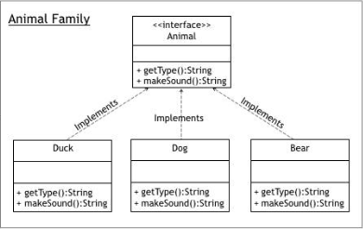






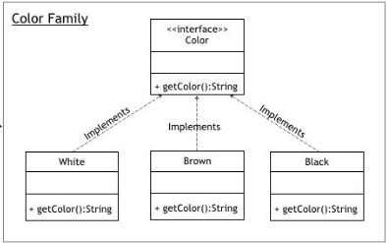


Notes:
Abstract Factory defines an interface for creating families of related objects,
while Factory Provider is responsible for selecting and returning the appropriate factory based on client input.
Simple Analogy
Think of a Mall
Factory Provider = Reception Desk Tells you which shop to go to
Abstract Factory = Shop Gives you the product
Product = Item you buy

Slide 112
Elements of Abstract Factory Pattern
AbstractFactory (The Master Blueprint)
What it is: The top-level interface or general rulebook.
What it does: It tells the system how to make a group of related factories. The user (client) only interacts with this blueprint, which hides the messy, behind-the-scenes details of how things are actually built.
Notes:
AbstractFactory (Main Factory Interface)
👉 What it is: A blueprint for factories
👉 Simple idea: It tells what a factory can create, but not how
👉 example:
abstract class AbstractFactory { abstract Bank getBank(String bank); abstract Loan getLoan(String loan); }
In simple words:
“Any factory must be able to create Bank or Loan objects”

Slide 113
ConcreteFactory (The Specific Builder)
What it is: The actual, working factory (a specific version of the master blueprint).
What it does: It does the real heavy lifting. It contains the exact code to build the actual, specific products.
Notes:
What it is: Actual factories that create real objects
example:
BankFactory
LoanFactory
“This factory knows HOW to create specific objects”

Slide 114
AbstractProduct (The General Item Category)
What it is: A broad category describing what a specific item should be.
What it does: It defines the basic rules for a product. When you ask the factory for this item, it guarantees you get the exact version that perfectly matches the specific ConcreteFactory you are currently using.
Notes:
What it is: A common interface for products
example:
Bank
Loan
Example:

Slide 115
ConcreteProduct (The Final Item)
What it is: The actual, finished object created by the specific factory.
What it does: It contains the real, working code for that specific item.
It is the tangible result that fulfills all the rules laid out by the generic AbstractProduct category.
Notes:
What it is: Actual objects created by factories
Examples:
ICIC, HBFC → Bank products
HomeLoan, BusinessLoan → Loan products

Slide 116
Client (The User or System)
What it is: The part of your program that actually needs to use these items.
What it does: It only interacts with the generic blueprints (AbstractFactory and AbstractProduct).
Because of this, the Client is "blissfully ignorant"—it doesn't know or care how the objects are built or what specific class they belong to.
It just asks for an item and trusts the system to hand it the right one.

Slide 117
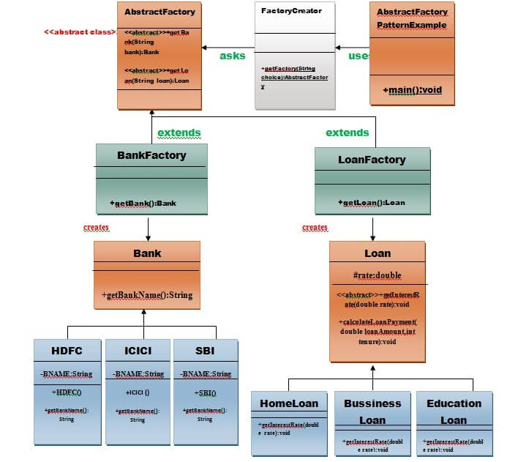

Slide 118
Example of Abstract Factory Pattern
Here, we are calculating the loan payment for different banks like HDFC, ICICI, SBI etc.
Step 1: Create a Bank interface
import java.io.*;
interface Bank
{
String getBankName();
}

Slide 119
Step 2:
class HDFC implements Bank { private final String BNAME = "HDFC BANK"; @Override public String getBankName() { return BNAME; } }

Slide 120
Step 2:
class ICICI implements Bank { private final String BNAME = "ICICI BANK"; @Override public String getBankName() { return BNAME; } }

Slide 121
Step 2:
class SBI implements Bank { private final String BNAME = "SBI BANK"; @Override public String getBankName() { return BNAME; } }

Slide 122
Step 3: Create the Loan abstract class.
abstract class Loan { protected double rate; abstract void getInterestRate(double rate); public void calculateLoanPayment(double loanAmount, int years) { int n = years * 12; double monthlyRate = rate / 1200; double EMI = (monthlyRate * Math.pow(1 + monthlyRate, n)) / (Math.pow(1 + monthlyRate, n) - 1) * loanAmount; System.out.println("Monthly EMI: " + EMI + " for loan amount: " + loanAmount); } }

Slide 123
Step 4: Create concrete classes that extend the Loan abstract class..
class HomeLoan extends Loan { @Override void getInterestRate(double r) { rate = r; } } class BusinessLoan extends Loan { @Override void getInterestRate(double r) { rate = r; } } class EducationLoan extends Loan { @Override void getInterestRate(double r) { rate = r; } }

Slide 124
Step 5:
Create an abstract class (i.e AbstractFactory) to get the factories for Bank and Loan Objects.
abstract class AbstractFactory{
public abstract Bank getBank(String bank);
public abstract Loan getLoan(String loan);
}

Slide 125
Step 6:
Create the factory classes that inherit AbstractFactory class to generate the object of concrete class based on given information.
class BankFactory extends AbstractFactory {
@Override
public Bank getBank(String bank) {
if (bank == null) {
throw new IllegalArgumentException("Bank type cannot be null");
}
switch (bank.toLowerCase()) {
case "hdfc":
return new HDFC();
case "icici":
return new ICICI();
case "sbi":
return new SBI();
default:
throw new IllegalArgumentException("Unknown bank type: " + bank);
}
}
@Override
public Loan getLoan(String loan) {
// BankFactory does NOT create Loan objects
throw new UnsupportedOperationException("BankFactory cannot create Loan objects");
}
}

Slide 126
Step 6:
class LoanFactory extends AbstractFactory { @Override public Bank getBank(String bank) { throw new UnsupportedOperationException("LoanFactory cannot create Bank"); } @Override public Loan getLoan(String loan) { if (loan == null) { throw new IllegalArgumentException("Loan type cannot be null"); } switch (loan.toLowerCase()) { case "home": return new HomeLoan(); case "business": return new BusinessLoan(); case "education": return new EducationLoan(); default: throw new IllegalArgumentException("Invalid Loan Type: " + loan); } } }

Slide 127
Step 7:
Create a FactoryCreator class to get the factories by passing an information such as Bank or Loan.
class FactoryCreator
{ public static final String BANK = "bank"; public static final String LOAN = "loan"; public static AbstractFactory getFactory(String choice)
{ if (choice == null)
{ throw new IllegalArgumentException("Factory type cannot be null"); } switch (choice.toLowerCase())
{ case BANK: return new BankFactory(); case LOAN: return new LoanFactory(); default: throw new IllegalArgumentException("Unknown factory type: " + choice); } } }

Slide 128
Step 8:
Use the FactoryCreator to get AbstractFactory in order to get factories of concrete classes by passing an information such as type.
import java.util.Scanner; class AbstractFactoryPatternExample
{ public static void main(String[] args)
{ Scanner sc = new Scanner(System.in); System.out.print("Bank: "); String bankName = sc.nextLine(); System.out.print("Loan Type: "); String loanName = sc.nextLine(); System.out.print("Rate: "); double rate = sc.nextDouble();

Slide 129
Step 8
System.out.print("Amount: "); double amount = sc.nextDouble(); System.out.print("Years: "); int years = sc.nextInt(); Bank bank = FactoryCreator.getFactory("Bank").getBank(bankName); Loan loan = FactoryCreator.getFactory("Loan").getLoan(loanName); System.out.println("\nLoan from: " + bank.getBankName()); loan.getInterestRate(rate); loan.calculateLoanPayment(amount, years); } }

Slide 130
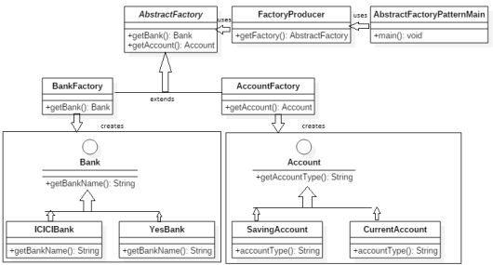
Notes:
Bank & Account Abstract Factory
Classes Involved:
BankFactory and AccountFactory: Abstract factories
Bank and Account: Abstract products
ICICIBank, YesBank: Concrete products of Bank
SavingAccount, CurrentAccount: Concrete products of Account
How it works:
BankFactory has a method getBankName() that returns a Bank object.
AccountFactory has a method getAccount() that returns an Account object. Depending on which factory is used, the correct bank or account object is created (e.g., ICICIBank or SavingAccount).
Goal: To create families of related or dependent objects (banks and accounts) without specifying their concrete classes.

Slide 131
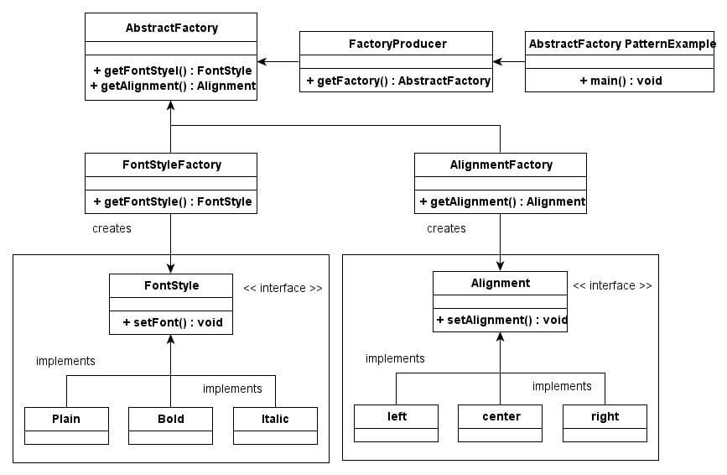
Notes:
Font Style & Alignment Abstract Factory
Classes Involved:
AbstractFactory: Defines getFontStyle() and getAlignment().
FactoryProducer: Decides which factory to return.
FontStyleFactory and AlignmentFactory: Concrete factories
FontStyle, Alignment: Interfaces for products
Plain, Bold, Italic: Concrete font styles
left, center, right: Concrete alignments
How it works:
FactoryProducer provides the right factory (either for font or alignment).
FontStyleFactory creates objects like Plain, Bold, etc.
AlignmentFactory creates left, center, or right alignments.
Goal: To demonstrate that multiple related object families (font + alignment) can be created without depending on concrete classes.

Slide 132
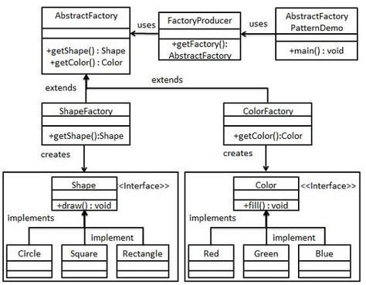
Notes:
Shape & Color Abstract Factory
Classes Involved:
AbstractFactory: Has methods getShape() and getColor().
FactoryProducer: Returns the correct factory based on need.
ShapeFactory and ColorFactory: Concrete factories
Shape and Color: Interfaces for products
Implementations (not shown in detail): likely Circle, Square for Shape; Red, Blue for Color.
How it works:
FactoryProducer is asked for either a shape or color factory.
ShapeFactory can return a Shape object with a draw() method.
ColorFactory can return a Color object with a fill() method.
Goal: Create UI objects (shapes, colors) independently but using a unified factory interface.

